Slide 1
CBRE Capital Markets
Investment Properties - Debt & Equity Finance
Kevin L. Randles
Senior Vice President kevin.randles@cbre.com
January 25, 2013
The Appraisal Institute : Sacramento Sierra Chapter

Slide 2
Table of Contents
Economic Factors Affecting Capital Flows
  Observations
Debt Market Overview
  Recent Lender Survey
  Current Mortgage Rates
  Various Data
Equity Market Overview
  Various Data
Notes:
TWR Pre-set (Meghan Gorman)

Slide 3
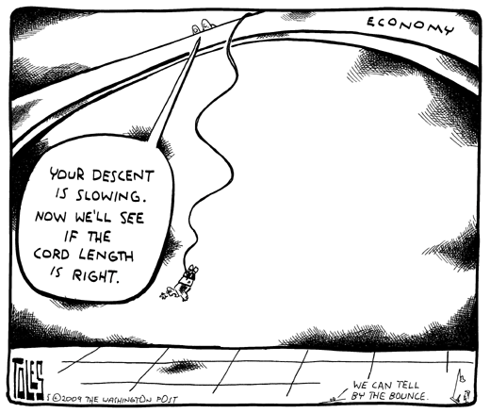
Uncertainty & Continued Correction

Slide 4
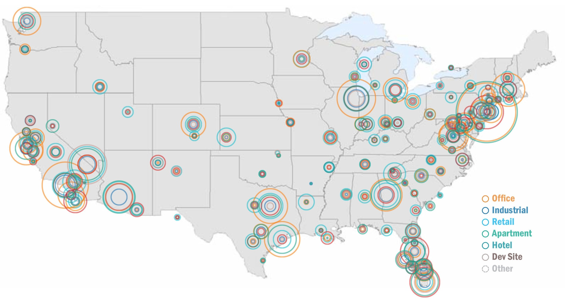
Distress Across the US
The commercial real estate market is improving at a modest pace, but newly troubled properties continue to enter the distress pool.
Source: RCA Troubled Assets Radar, May 2012 – Bubbles are sized to relative distress values

Slide 5
Loans in Special Servicing by Property Type
Totaling $57.53 billion across 3,421 loans
Source: Morningstar Monthly Delinquency Report, September 2012

Slide 6
Improvements Being Made
Loans in Special Servicing as % of CMBS Outstanding
Source: Morningstar Monthly Delinquency Report, September 2012

Slide 7
Top Metros Leading Distress Space
The Metros below account for 67% of distressed and potentially troubled assets:
Source: CBRE Research and RCA Troubled Assets Radar, October 2012

Slide 8
On a Relative Basis, Distress In Las Vegas Stands Out!
$3 Billion?
Over $25 Billion
Relative Distress =
(Metro Distressed Asset/Metro Employment ) / ( Total Distressed Asset/Total Employment ) ➔ 1 = Average Level of Distress
Source: RCA, Troubled Assets Radar and CBRE Research, October 2012

Slide 9
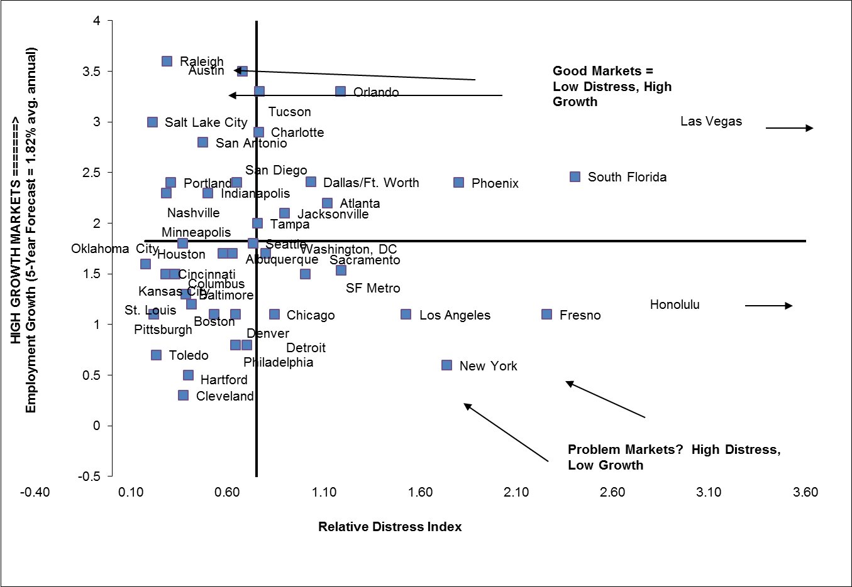
Distress Is All Relative: Which Distressed Markets Also Face A Weak Demand Outlook
Source: CBRE Research, CBRE-EA, and RCA, October 2012

Slide 10
Vacancy Moving From Cyclic Highs
With vacancy high relative to long-term trends, rents are still under pressure.
 |  | 2012Q2 | Past Cyclic High | “Natural Rate” | Year Back to "Natural Rate"
Office | Vacancy Rate | 15.7 | 16.8 / 2010 | 13 to 15 | 2013
Industrial | Availability Rate | 13.2 | 14.5 / 2010 | 9 to 10 | 2015
Retail | Availability Rate | 13.0 | 13.2 / 2011 | 9 to 10 | 2017
Multifamily | Vacancy Rate | 4.8 | 7.41 / 2009 | 5 to 6 | 2010
Full Service Hotels | Vacancy Rate | 26.2 | 43 / 2009 | 34 to 38 | 2010
Source: CBRE Econometric Advisors, Q2 2012
Notes:
In the short term top performing office markets will be gateway cities such as Boston, New York and San Francisco and high-tech markets like Austin, Dallas, Pittsburgh and Salt Lake.
U.S. Industrial availability expected to decline next year to 12.5%, and 11.3% by the end of 2013.
The retail availability rate has remained flat, however demand recovery is not in full swing, that will be seen in a few more quarters of improving availability rates
Strongest growth for multifamily demand is in San Jose, San Francisco, Oakland, Seattle, New York and Boston
Sales from distressed hotels accounted for over 65% of the sector’s volume
10

Slide 11
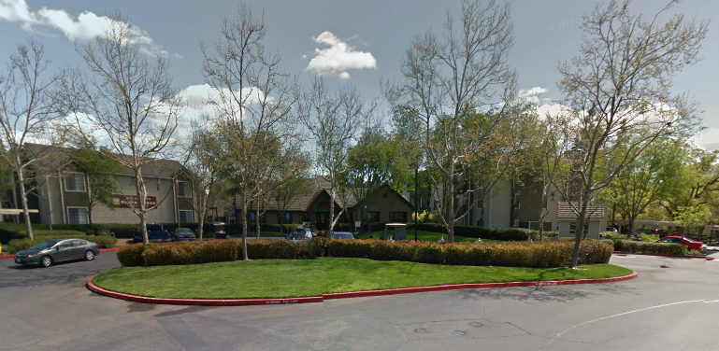

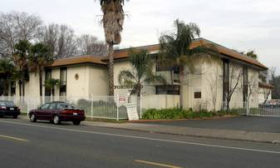
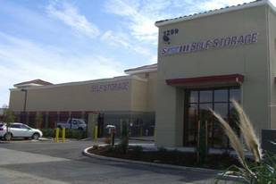
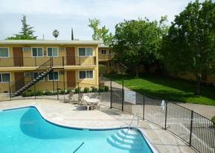
Smart Money Invests Early In Cycle
Sample Wins
Slate Creek Apts – Roseville
May-2011: $76.5mm
Jan-2010: $54.3mm
Yuba Street Office – Marysville
Jan-2011: $4.7mm
Sep-2009: $2.3mm
Portofino Apts – Sacramento
Sep-2012: $1.6mm
Jun-2011: $1.2mm
Self Storage – Roseville
Sep-2012: $4.3mm
Apr-2011: $3.8mm
Oak Plaza Apts – Sacramento
Aug-2012: $2.1mm
Apr-2010: $1.1mm
Notes:
11

Slide 12
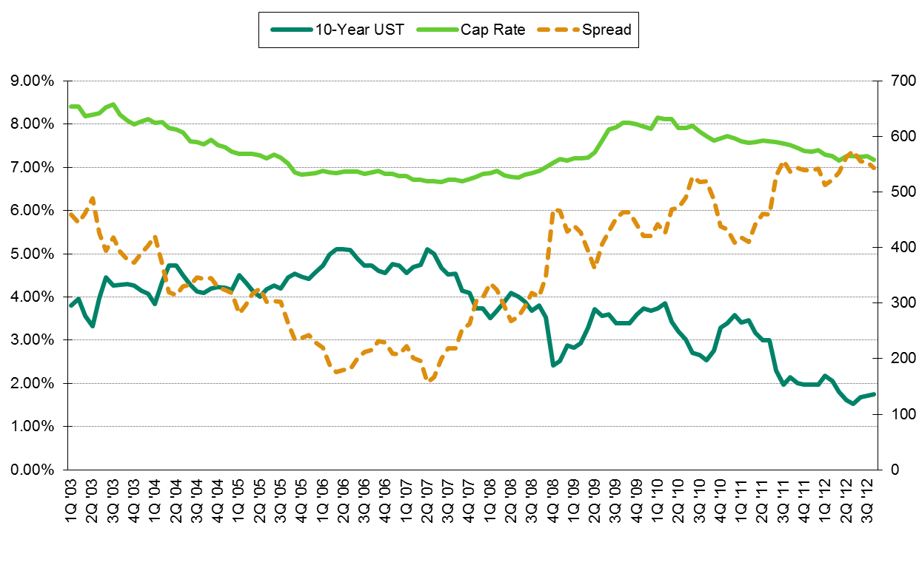
Smart Money Invests Early In Cycle
Cap Rates & UST Yields : Risk Return Spread
500 BP Spread – 3X Historical!
Interest Rates Have Room To Rise Without Hurting Cap Rates
Source: Real Capital Analytics, US Caps & Spreads (Data through Q3 2012)

Slide 13








Improving Balance Sheets
Domestic Bank Profits Up
Net Income: $21 Billion
Net Income:$5 Billion 2012 (Up 10X PY)
Net Income:$4.2 Billion 2012 (Up 4X PY)
Net Income:$19 Billion
Net Income:$3 Billion
Net Income:$7.5 Billion
Net Income:$2 Billion (Up 1.5X)
Net Income:$600 Million (Up 3X)
Source: Monringstar.com
Notes:
13

Slide 14
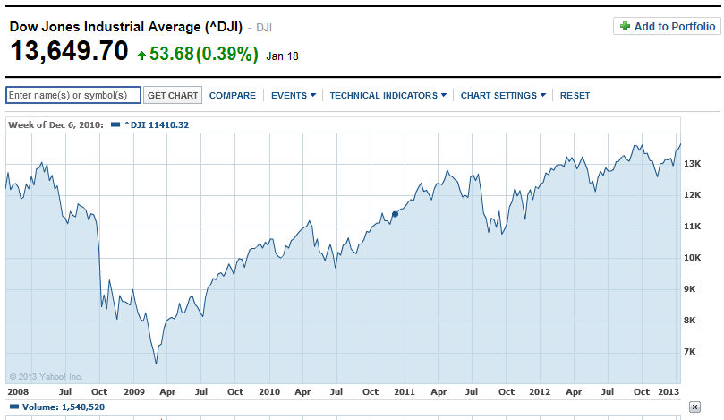
Improving Balance Sheets
DJIA Recovers
Jan-2013: 13,600
Mar-2009: 6,800
Source: Morningstar.com
Notes:
14

Slide 15
Debt Market Overview

Slide 16
Debt Capital Markets Update
Historically low rates great for borrowers
Risk adjusted spreads attractive for lenders verses corporate’s
Returns for savers (pension funds and retirees) poor
Monetary Policy (QE-III “Infinity”) supports prolonged period of low rates
Many New Lenders formed to move up risk curve for higher rates (Structured Bridge, Mezz, Preferred Equity, JV Equity)
Relationship Lending
Large loans and portfolio loans are in demand
Flight to quality for best pricing / proceeds (3.5% 10 Yr Floor)
Less efficient market – Need to find “Sweet Spot” for lenders – wide variation of quotes for any given deal
Pundits Split: Half forecast low rates while Others forecast rise in rates
Notes:
16

Slide 17
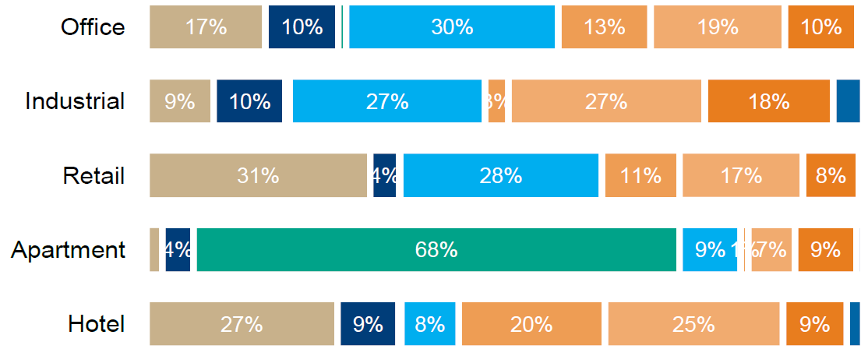
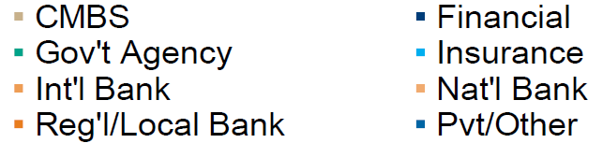
1H 2012 Lender Composition
Improvements made in availability and cost of commercial mortgages
Issuance of agency, private label CMBS, and REIT unsecured notes exceeded full-year 2011 levels
Composition of lenders varied greatly between property types
Source: Real Capital Analytics
Notes:
17

Slide 18
Debt Capital Markets Update
Life Companies
  Life Co. volume +/-$45 Billion in 2012 – expect similar allocations in 2013
  Large loans and portfolio loans are in demand
  More conservative, but great execution
  Forwards returning and some offering higher yielding mezzanine
CMBS
  CMBS is stepping up again (secondary markets / B assets) +/-$ 45 Billion in 2012
  CMBS spreads and rates have moved in – Rates at 4% (10 year term)
  Higher LTV’s, but for a price
  Dozen active lenders in the market
Banks
  Using the balance sheet again
  Likely investing $150 Billion (50% of total commercial mortgage market)
  May offer longer term loans with some non-recourse availability
  Most active at 5 year term
GSE’s (Freddie and Fannie)
  $50B plus volume in 2012, pressure from FHFA to be more conservative (i.e. less interest only and cash out refinances)
  Great execution in primary and some secondary cities
  Market share declining with competition
  Uncertain future; Most all loans are securitized (MBS)
Notes:
18

Slide 19




















Lender Survey: More of Same Plus More Risk
2012: $45 Billion Invested in Mortgage Loans & Delinquency Rate <0.1%
(About 15% Retained; Balance New; Poor to CMBS or Bank)
2013:
1) Small Growth of 3% in Allocations
2) New Hires Relegated to Replacing Retirees
3) Concerns: a) Too Much Capital, b) Declining Life & Annuity Sales
4) Expect To Be Forced To Take On More Risk
5) 10-Yr Floor Rate: 3.5%
Notes:
19

Slide 20
CBRE Loan Originations : 3Q2012
 | 3Q 2012 YTD | 3Q 2011 YTD | % chg
Office | $2.85B | $1.96B | 45%
Retail | $0.83B | $1.29B | -36%
Industrial | $0.78B | $1.05B | -26%
Multi-Housing | $7.75B | $5.69B | 36%
Hotels | $0.28B | $0.26B | 8%
Special Purpose | $0.60B | $1.15B | -48%
US Loan Origination Volume | $13.09B | $11.40B | 15%
US Loan Sales Volume | $1.39B | $1.55B | -10%
Total Loan Activity Volume | $14.48B | $12.95B | 12%
Total Investment Sales Volume* | $25.81B | $23.29B | 11%
Total US Capital Markets Activity | $40.29B | $36.24B | 11%
Debt & Equity Finance
12% Share of All Non-Bank Loans
Notes:
20

Slide 21
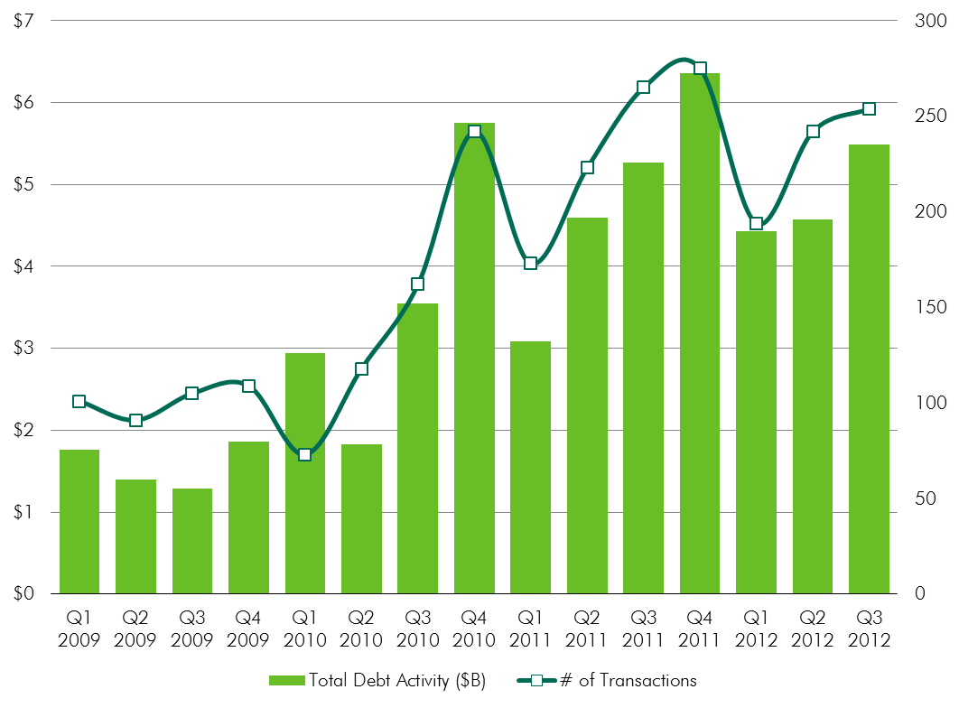
CBRE Loan Activity Volume
CBRE 2012:
$20 Billion+
900+ Loans
Source: CBRE Capital Markets Loan Originations and Loan Sales

Slide 22
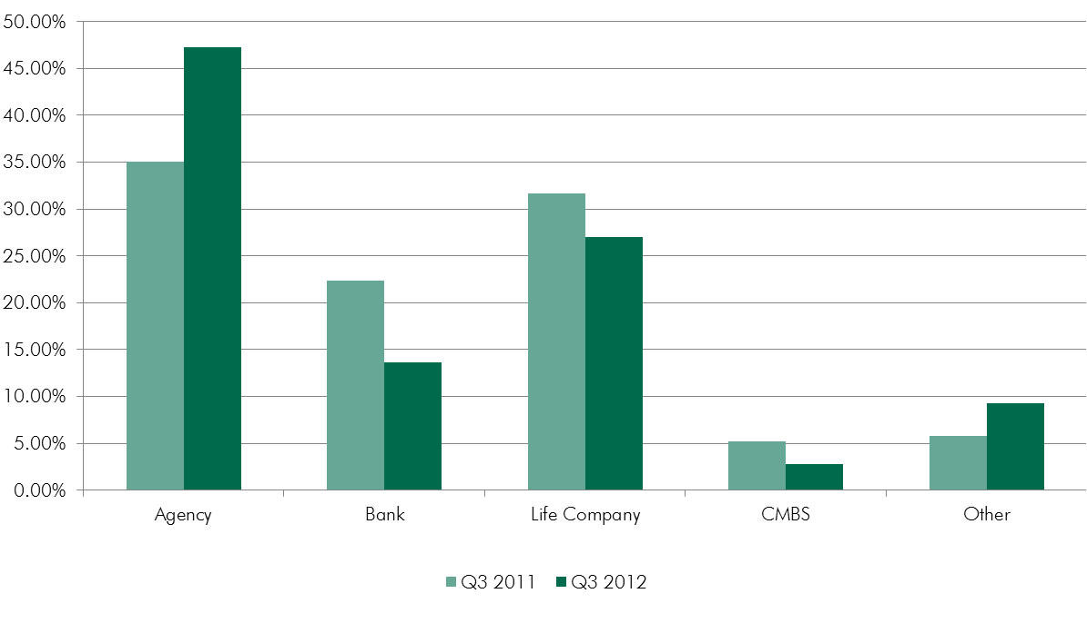
Who’s Lending
Percentage of Total Consideration
Source: CBRE Econometric Advisors, Q3 2012
Notes:
During the second quarter of 2012, lending activity clearly tilted toward the agencies -- Fannie Mae and Freddie Mac originated loans accounted for 47% of total lending. This figure was up from a 33% share recorded during the first quarter and 23% a year earlier. With strong interest in multifamily acquisition financing, the slowdown in agency lending was been less pronounced during the second quarter, which has accounted for the agencies' increase in share.
Life company originations were particularly sluggish during the second quarter. As lending volume improved after the recession, life companies, along with the agencies, have been a reliable source of debt capital. However, during the second quarter of 2012, life companies' share of total lending fell to only 17% - compared with 24% during the first quarter and 29% a year earlier. The second quarter performance also marked the first period in recent memory that banks' share of lending exceed that of the life companies. While the banks overall continue to struggle with struggling with problem loans, which has hampered their ability to generate new business, there are signs that their commercial portfolios are improving and they are becoming more likely to extend credit to both existing and new borrowers. As we noted during last quarter's edition of the Lender Forum, delinquencies on banks and thrifts' loan commercial real estate loan portfolios have been declining over the last several quarters, after reaching a peak in mid-2010. In addition, banks have are rapidly working through their inventory of troubled construction loans; combined with improved capital reserves, they appear better positioned to take advantage of improving loan demand.

Slide 23
U.S. Commercial & Multifamily Debt Outstanding
By Capital Source
Total $2.37 Trillion
Source: Mortgage Bankers Association, Q2 2012
Notes:
“The level of commercial/multifamily mortgage debt outstanding decreased by $10.4 billion, or 0.4 percent, in the second quarter of 2012, as the balance of loans in CMBS, CDO and other ABS issues continued to decline, according to the Mortgage Bankers Association (MBA).
The $2.37 trillion in outstanding commercial/multifamily mortgage debt was $10.4 billion lower than the first quarter 2012 figure. Multifamily mortgage debt outstanding rose to $826 billion, an increase of $5.4 billion or 0.7 percent from the first quarter of 2012.” – Debt Outstanding (MBA), Q2 2012

Slide 24
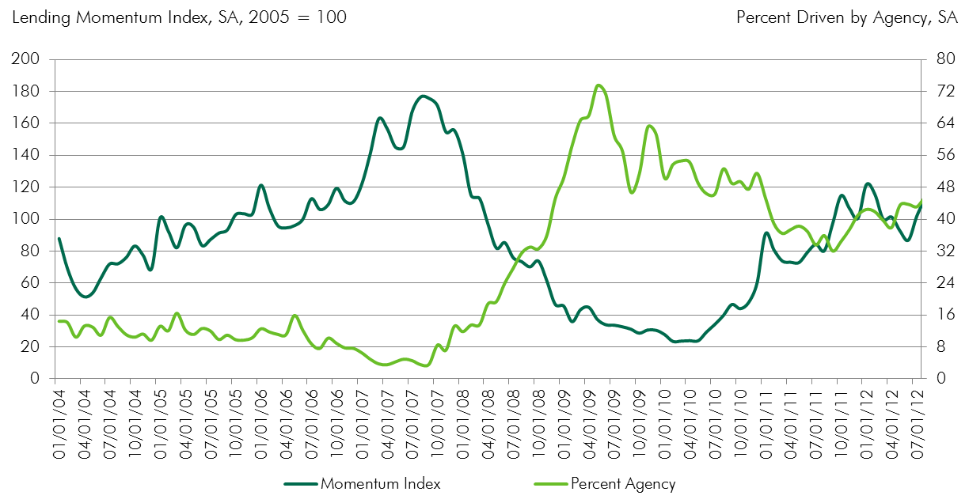
CBRE Lending Momentum Index
Private Sources Dominate
Public Sources Dominate
Source: CBRE Capital Markets, CBRE Research, data as of September 30, 2012. Seasonally Adjusted.
Notes:
Examining a proprietary database of loan data, CBRE-EA has created an index tracking the momentum of deal activity in the market for commercial mortgage loans.
The index shows increases in lending activity through January 2012, before a retrenchment of gains through June 2012. Since June, the index has registered additional growth to reach a level just shy of its January peak. To interpret the index, one has to place it in historical context. The index stood at a value of 24 in March of 2010 versus a high of 177 in August 2007. The way to interpret this change is in absolutes; there was an 86% decline in lending volume over this 31-month period. Having reached this bottom, lending activity has been generally recovering over this period, reaching the value of 122 in January 2012. In September the index reached a value of 119, which represented a 36% increase over its most recent low, which was registered at 87 in June. Compared to activity one year ago, September's index was 22% higher.
As the chart indicates, there was a surge in the percentage of all loans that were driven by Agencies from 2007 onward when other sources of lending pulled back. The share of agency loans peaked at 73% in May 2009. Agency share declined since then as other sources of lending picked up -- for most of 2011 the share stayed near 35%. However, over the course of 2012, the agency share of total lending advanced to its highest levels since early 2010. In August and September, it contributed close to 45% of total lending activity.
24

Slide 25
Loan Maturities
By Investor Type
Source: Mortgage Bankers Association, Q4 2011. Updated Annually.
Notes:
Ten percent or $150.6 billion of the balance of commercial and multifamily mortgages held by non-bank lenders and investors will mature in 2012, a 3 percent decline from the $154.7 billion that matured in 2011, and an 18 percent decline from 2010. The principal balance of maturing mortgages falls to $107.5 billion in 2013 and $108.9 billion in 2014, before climbing in 2015, 2016, and 2017 as the ten year loans made in 2005, 2006 and 2007 begin to come due. - Loan Maturities Volumes (MBA) December 31, 2011
25

Slide 26
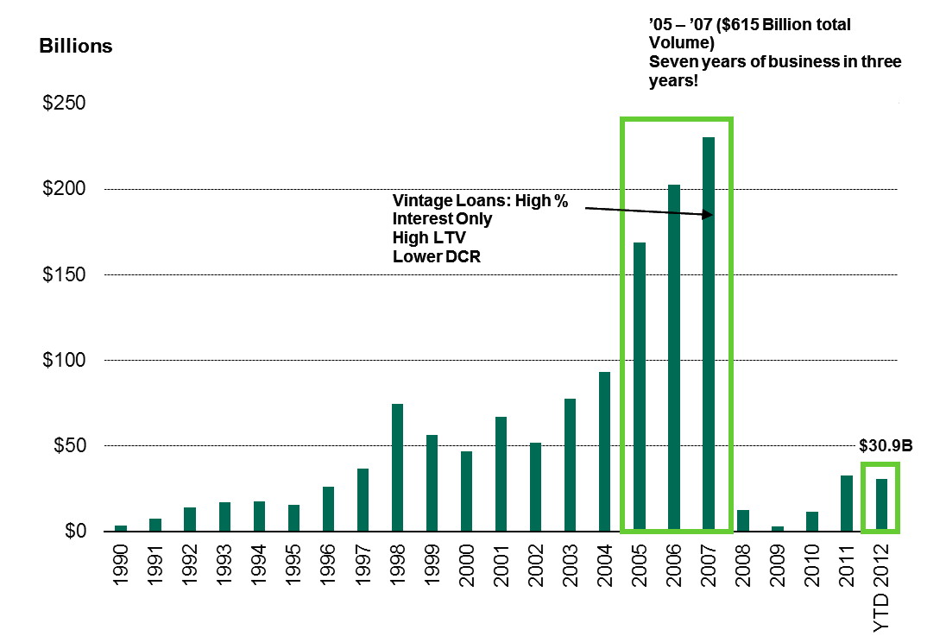
CMBS Issuance
Source: Commercial Mortgage Alert, October 2012
Notes:
As of 10/5/12
2012: $30.9B
2011 (comparison): $26.9B
26

Slide 27
Key Indices
 | Prime | 5-Yr T | 10-Yr T | 1-M LIBOR | DJIA
1.18.2013 | 3.25% | 0.77% | 1.87% | 0.21% | 13,650
9.12.2012 | 3.25% | 0.69% | 1.75% | 0.22% | 13,351
Year Ago | 3.25% | 1.11% | 2.16% | 0.24% | 11,416
Source: Bloomberg, Federal Reserve
Notes:
27

Slide 28
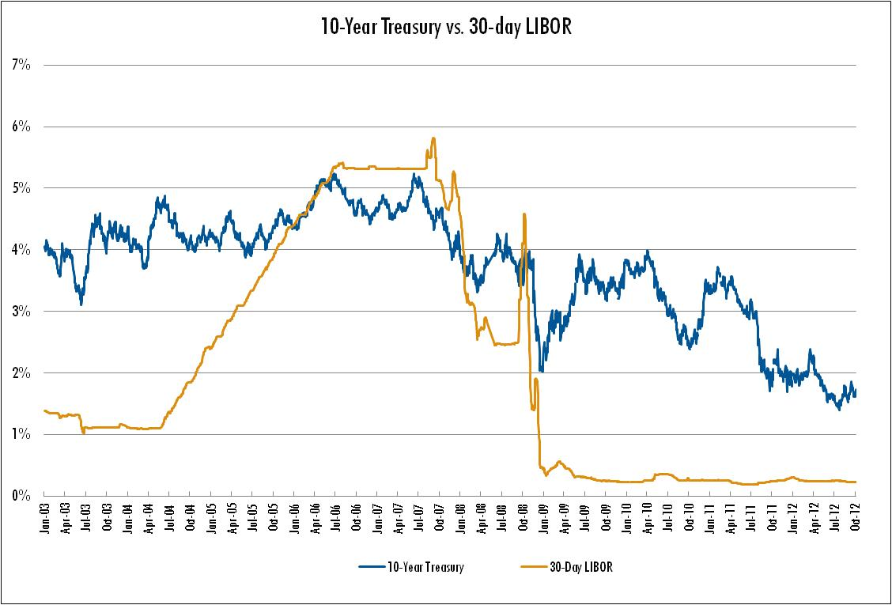
10-Year Treasury vs. 30-day LIBOR
Source: Federal Reserve, October 2012

Slide 29
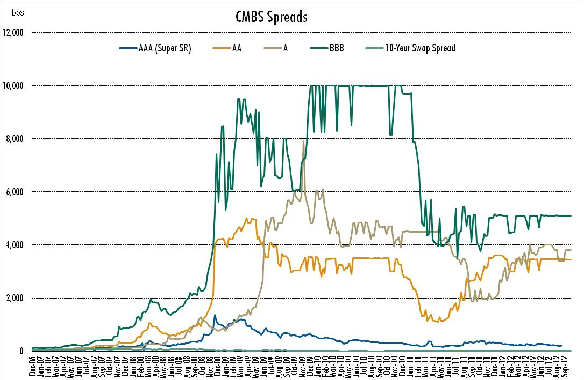
CMBS Spreads
Source: Citibank, October 2012

Slide 30
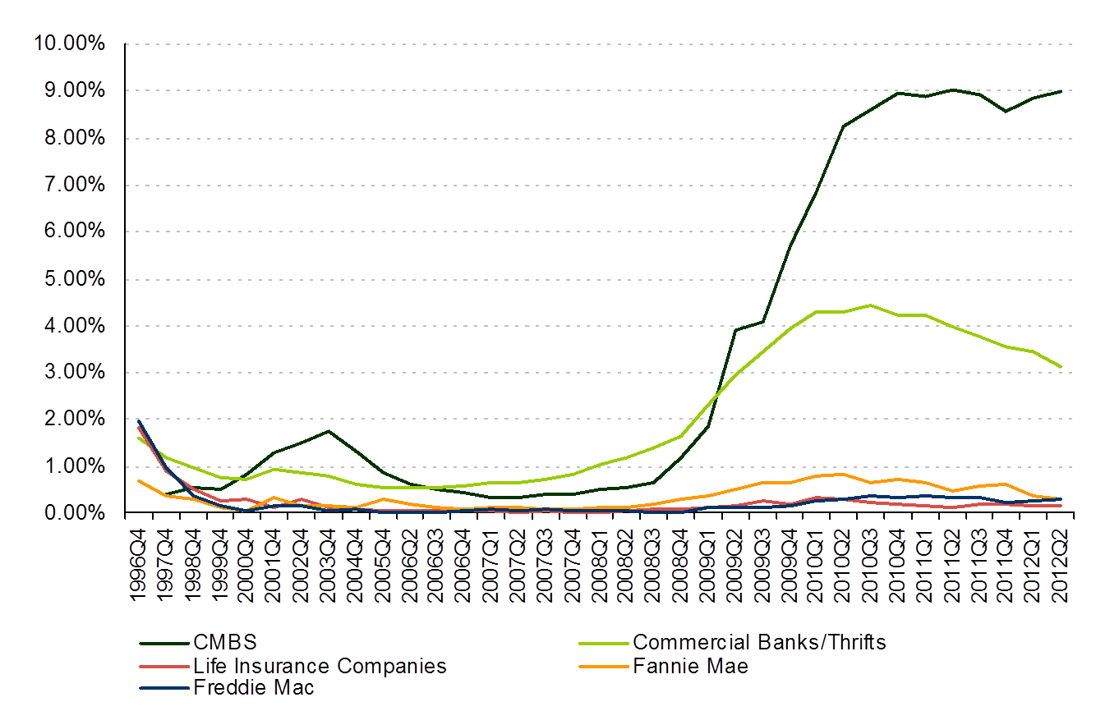
Delinquency Rates
CMBS
Banks
Source: MBA, ACLI, Wells Fargo, Fannie Mae, Freddie Mac, OFHEO and FDIC, Q2 2012
Notes:
30
“Commercial and multifamily mortgage delinquency rates dropped for banks and rose for commercial mortgage backed securities (CMBS) during the first quarter of 2012. Delinquency rates also declined for life insurance companies and Fannie Mae during the first quarter, and increased by 0.01 percentage points for Freddie Mac according to the Mortgage Bankers Association’s (MBA) Commercial/Multifamily Delinquency Report.
During the first quarter of 2012, the 60+ day delinquency rate for commercial and multifamily mortgages held in life company portfolios decreased 0.03 percentage points to 0.14 percent. The 60+ day delinquency rate for multifamily loans held or insured by Fannie Mae decreased 0.22 percentage points to 0.37 percent. The 90+ day delinquency rate for loans held by FDIC insured banks and thrifts decreased 0.13 percentage points to 3.44 percent. The 60+ day delinquency rate for multifamily loans held or insured by Freddie Mac increased 0.01 percentage points to 0.23 percent. The 30+ day delinquency rate for loans held in commercial mortgage-backed securities (CMBS) increased 0.29 percentage points to 8.85 percent.

Slide 31
Commercial/Multi-Housing Delinquency Rates by Lender
Source: MBA, ACLI, Wells Fargo, Fannie Mae, Freddie Mac, OFHEO and FDIC, Q2 2012
Notes:
31

Slide 32
Who’s Lending?
Aetna Life Insurance | AIG | Allstate Investments | Bank of America | Bentall Kennedy | CCRE | Capital Source Finance
CBRE Global Investors | Charter One Bank | CIBC | CIGNA | Citigroup | Cornerstone | Fannie Mae
Freddie Mac | GE | Goldman Sachs | Great West Life & Annuity | HSBC Bank | HUD FHA | ING
John Hancock | JP Morgan | Landesbank | MetLife | New York Life | NorthStar Funding | Northwestern Mutual
NXT Capital | Pacific Life | PB Capital | Peoples United Bank | PPM | Principal Real Estate Investors | Prudential
Quadrant | RBS | Sovereign Bank | Stancorp | Starwood | TD Bank | TIAA-CREF
Hartford Investment | Provident Bank | UBS | UNUM | UOB | U.S. Bank | Wells Fargo
Source: CBRE Capital Markets, banks shown are a representative sampling and alphabetical order.
Notes:
32

Slide 33
Current Debt Pricing

Slide 34
Yesterday, Today and Tomorrow
2007
2009
2012 Today
Loan Breakout
Source: Mortgage Bankers Association, CBRE EA
Notes:
34

Slide 35
Financing Returns to Normalized 2005 Levels
 | 2007 Peak |  | 2009 Trough |  | 2012 Today
Net Operating Income | $ 2,400,000 |  | $ 2,400,000 |  | $ 2,400,000
Capitalization Rate | 6.00% |  | 8.50% |  | 7.00%
Asset Value | $ 40,000,000 |  | $ 28,235,000 |  | $ 34,286,000
10-year Treasury Rate | 4.60% |  | 3.60% |  | 1.70%
Spread | 1.00% |  | 3.00% |  | 2.50%
Rate | 5.60% |  | 6.60% |  | 4.20%
Years of Amortization | I-O |  | 25 |  | 30
Loan Constant | 5.60% |  | 8.18% |  | 5.86%
Maximum Loan to Value | 80% |  | 65% |  | 70%
Minimum DSCR | 1.15 |  | 1.30 |  | 1.25
Maximum Loan Proceeds based on Valuation | $ 32,000,000 |  | $ 18,352,750 |  | $ 24,000,200
Maximum Loan Proceeds based on DSCR | $ 37,267,000 |  | $ 22,576,000 |  | $ 32,720,000
Maximum Loan Proceeds (lesser amount) | $ 32,000,000 |  | $ 18,352,750 |  | $ 24,000,200
Equity Required ($) | $ 8,000,000 |  | $ 9,882,250 |  | $ 10,285,800
Equity Required (%) | 20% |  | 35% |  | 30%
Source: CBRE EA, CBRE Capital Markets
*Financing indicative of an acquisition deal. I-O Interest Only

Slide 36

Case Study: 3805 Faraday : Davis
$8 Million Finance of Flex Property
The Situation
The flex warehouse project housed a single tenant for the 71,000 Sq. Ft. and had not yet fully ‘staffed’ the property. The developer agreed to sell the property to an investor.
The Challenge
Locate suitable financing that would supply a long term fixed rate with ample leverage to meet the 1031 trade capital needs of the investor, plus supply flexible deal points for certain future events.
The Result
CBRE Capital Markets team arranged a 12-year loan with the very best interest rate, while also attaining flexible deal features to appease the investor’s demands..
Former CEO of CBRE needed certainty of close on a 1031 trade and required a lender to stretch on valuation and soften loan covenants for a long-term estate plan transaction to provide for 100% future unlevered cash flows.
Notes:
36

Slide 37
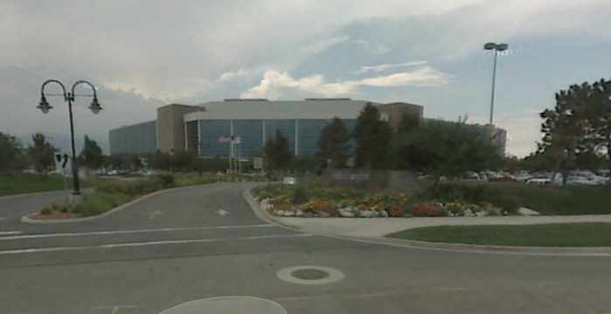
Case Study: United Health Facility : Utah
$10 Million Refinance for Office Property
The Situation
The 125,000 Sq.Ft. office building possesses a single tenant occupancy which was entering multiple short term extension periods.
The Challenge
To arrange a loan in order to refinance a rapidly maturing CMBS loan at sufficient proceeds while also supplying flexible term features to outlive the remaining term but also supplying protective covenants in case the single tenancy chose to vacate the property.
The Result
CBRE Capital Markets team arranged a five-year loan with a very low-interest rate coupled with automatic extension options and features to enhance property owner return on equity.
A property possessed a maturing ‘legacy’ level loan secured by a large single tenant property that previously entered into a short-term lease extension. We were able to structure covenants for both lender and borrower that accomplished a win-win transaction, including supporting loan collateral valuation.
Notes:
37

Slide 38
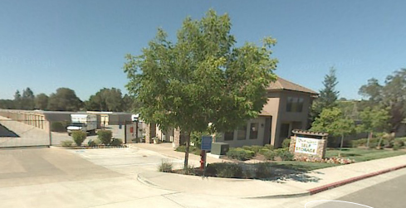
Case Study: Rock Creek Storage : Auburn
$3 Million Refinance for Self-storage Property
The Situation
The owners of the self-storage project recognized an opportunity to rapidly prepay its debt capital.
The Challenge
To arrange a loan to refinance existing debt capital but attain a very long term floating rate allowing for consistent principal reductions as compared to higher fixed rates.
The Result
CBRE Capital Markets team arranged a 15-year loan with a low floating interest rate meeting both owner and lender’s demands for market terms.
“In spite of the desire to rapidly repay the debt capital, all lenders were very concerned with the future of rising interest rates and would not entertain a floating rate for more than 5 years. CBRE devised a structure protecting lender to achieve a 15-year term floating rate for the owners of the property,” commented Kevin Randles, Senior Vice President at CBRE.
Notes:
38

Slide 39
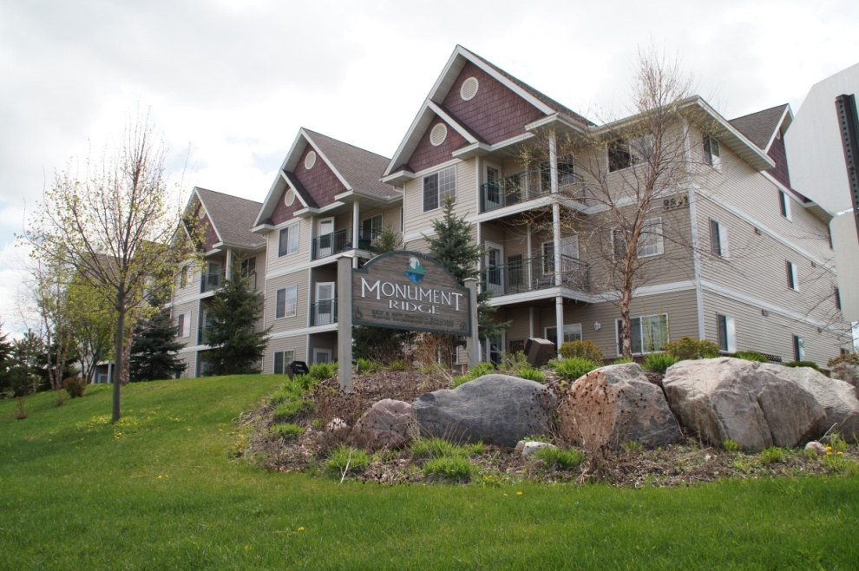
Case Study: Monument Ridge Estates
$10 Million Refinance for Multi-housing Property
The Situation
A class A 132 unit multi-housing property with Legacy level debt capital coming to maturity coupled with a Family Office intertwined with estate planning transfers and year end tax benefit motivations.
The Challenge
To arrange a large enough loan to cover the outstanding debt capital allowing the owners to retain liquidity for estate plans, while also attaining long term fixed rate to outlast possible future hyper-inflation in mortgage rates projected in 10-years by the owner.
The Result
CBRE Capital Markets team arranged a 15-year, early prepayable loan with a market leading low rate, including generating the largest proceeds through complete market exposure.
The client chose CBRE’s financing option due to largest loan proceeds, lowest rate and for the longest term available allowing the owner to retain its liquid assets for further estate planning efforts.
Notes:
39

Slide 40
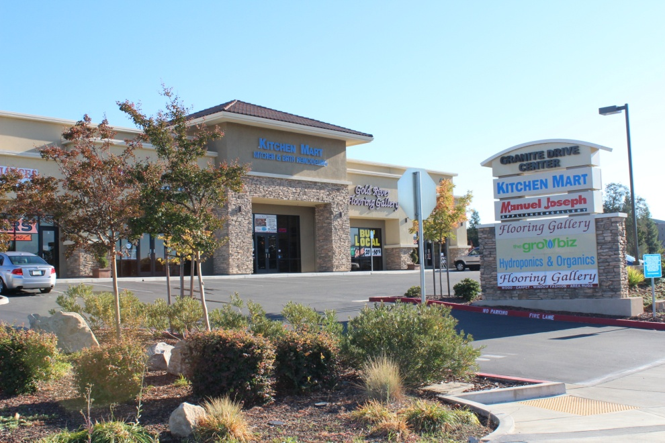
Case Study: Granite Drive : Rocklin
$2 Million Refinance of Commercial Property
The Situation
An investor acquired the distressed property for a low price and thereafter leased up the vacant space and stabilized operations.
The Challenge
To arrange a loan with reasonable metrics but with an amount that exceeded the total cost basis of the owner in the property, while the tenancies remained questionable due to their industry association with the housing industry.
The Result
CBRE Capital Markets team arranged a 25-year loan with an attractive low rate that allowed for 100% Loan To Cost.
The property owner valued CBRE’s strong lender relationships and control of the loan process to help attain a cash-out loan, which is not desirable by lenders at this stage of the cycle. Our local market knowledge provided confidence to the lender to make a commitment to the investment. Two additional properties were financed with the same owner and lender.
Notes:
40

Slide 41
Equity Market Overview

Slide 42
National Investment Sales Benchmarks
 |  |  |  |  |  |  | NATIONAL INVESTMENT SALES
 |  |  |  |  |  |  | BENCHMARKS
 | APARTMENT | HOTEL | INDUSTRIAL | OFFICE | RETAIL | TOTAL | %CHANGE
2003 | $30.1 | $1.3 | $14.4 | $49.2 | $28.6 | $123.6 | n/a
2004 | $50.9 | $13.3 | $21.0 | $76.4 | $40.6 | $202.1 | 63.4%
2005 | $90.6 | $26.4 | $39.8 | $104.2 | $51.3 | $312.3 | 54.5%
2006 | $89.2 | $30.8 | $44.3 | $127.9 | $49.6 | $341.8 | 9.5%
2007 | $79.1 | $34.0 | $51.8 | $161.3 | $53.1 | $379.4 | 11.0%
2008 | $38.7 | $11.9 | $23.8 | $56.8 | $22.2 | $153.3 | -59.6%
2009 | $16.5 | $3.3 | $9.4 | $18.1 | $13.3 | $60.7 | -60.4%
2010 | $35.6 | $9.8 | $18.1 | $51.4 | $22.0 | $136.9 | 125.5%
2011 | $56.6 | $20.8 | $24.8 | $75.7 | $36.8 | $214.6 | 56.8%
Q3 2012 | $45.8 | $10.8 | $20.9 | $50.7 | $32.4 | $160.6 | -25.2%
T10Y AVG $53 $16 $27 $77 $35 $209 Billion
Source: CBRE Econometric Advisors, Q3 2012
Notes:
42
Presentation Notes:
Annualized 2010 sales volumes settle in at 2001/02 levels.

Slide 43
Cap Rate Forecast by Property Type
Hotels 8.0%
Source: CBRE Econometric Advisors, Q3 2012
Notes:
43

Slide 44
CBRE’s US Capital Markets Activity Levels
Investment Properties
 | 3Q 2012 YTD | 3Q 2011 YTD | % chg
Office | $7.27B | $8.46B | -14%
Retail | $2.95B | $2.90B | 2%
Industrial | $4.85B | $4.30B | 13%
Multi-Housing | $9.23B | $5.58B | 65%
Hotel | $0.65B | $0.87B | -25%
Investment Sales Volume* | $24.94B | $22.13B | 13%
Buyer Rep | $0.87B | $1.16B | -25%
US Investment Sales Volume | $25.81B | $23.29B | 11%
Total US Loan Activity Volume** | $14.48B | $12.95B | 12%
Total US Capital Markets Activity | $40.29B | $36.24B | 11%
CBRE 20% Share
* US Investment Sales data as reported by Real Capital Analytics. Data does not include CBRE’s individual property sales valued at less than $2.5 million
** Loan Activity Volume includes Loan Originations and Loan Sales
Notes:
44

Slide 45
National Value Trends – Apartments
Source: CBRE Econometric Advisors, Q2 2012
Notes:
45
Values and cap rates in line with 2004 levels.

Slide 46
National Value Trends – Industrial
Source: CBRE Econometric Advisors, Q2 2012
Notes:
46
Values and cap rates in line with 2008 levels.

Slide 47
National Value Trends – Office
Source: CBRE Econometric Advisors, Q2 2012
Notes:
47
Values and cap rates in line with 2008/09 levels.

Slide 48
National Value Trends – Retail
Source: CBRE Econometric Advisors, Q2 2012
Notes:
48
Values and cap rates in line with 2004 levels.

Slide 49
Who’s Buying?
Commercial Real Estate Transactions Volume by Buyer Type
* Through Q3 2012
Source: Real Capital Analytics
Notes:
49
Q1 2012Transaction Volume by Buyer Capital Type:
Cross-Border – 9.9%
Inst'l/Eq Fund – 24.8%
Listed/REITs - 15.4%
Private - 40.2%
User/other - 6.4%
Unknown - 3.2%

Slide 50
Transaction Volume – by Buyer Capital Type
* Through Q3 2012
Source: Real Capital Analytics

Slide 51
Who’s Selling?
Commercial Real Estate Transactions Volume by Seller Type
* Through Q3 2012
Source: Real Capital Analytics
Notes:
51
Q1 2012 Transaction Volume by Seller Capital Type:
Cross-Border – 15%
Inst'l/Eq Fund – 26.2%
Listed/REITs - 7.7%
Private - 40.7%
User/other - 7.1%
Unknown - 3.1%

Slide 52
Transaction Volume – by Seller Capital Type
* Through Q3 2012
Source: Real Capital Analytics

Slide 53
Annualized Returns by Investment Type
* Through Q3 2012

Slide 54
Closing Thoughts : Forecast
Multi-housing sales activity will lead all sectors and might surpass $100B given the amount of investment capital and lenders’ willingness to lend.
  Over $100 billion of multi-housing debt was procured in 2012, of which Fannie & Freddie funded 60%. We expect Fannie & Freddie to increase production by 10 to 12% above the approximate $65 billion completed in 2012, which will be at least 50% of the projected debt volume.
  2/3rds of multi-housing sales occurred in the 2H2012
More distressed sales will clear as lenders accept more risk to aid funding deals.
Life companies are expected to increase debt production in the range of 10% for all product types. They will win more Multi-Housing property loans if they reduce their floors in rates.
Conduit issuance for all property types was up in 2012 by 50% to $48 billion. The 2013 consensus volume will be over $60 Billion range. CMBS will be more competitive in Multi-housing sector due to bond buyer demand.
* Through Q3 2012

Slide 55
Closing Thoughts : Forecast
No change in investor return requirements or cap rates, however, we expect a slight downward pressure in secondary markets as investors search for yield.
Deal flow up in 2013
Capital flows continue to increase in 2013, the bidder list for sales activity will mirror 2012, but will not be as robust as 2011 continuing the trend of the past year.
Investors increase willingness to pay above replacement cost in core markets is a sign that non-core market price increases will occur.
Expect to see new construction to occur in some secondary markets.
Monitor leasing activity. Should the spread for renewals increases above vacant units, then expect future rent growth to be challenged and a correction is possible. Multi-housing is close; still room to expand for Commercial & Industrial properties.
* Through Q3 2012

Slide 56
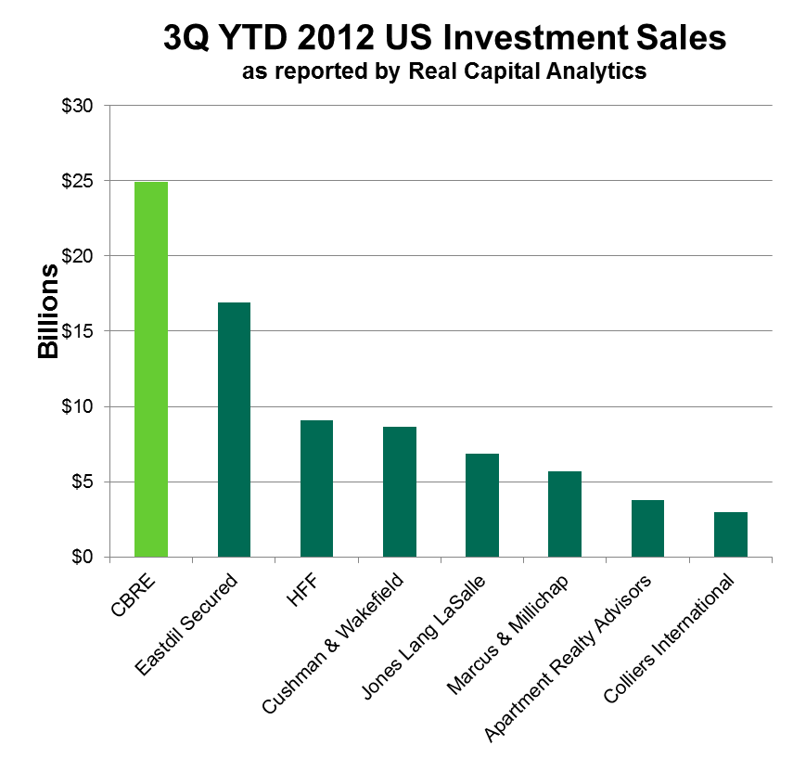
Real Capital Analytics 3Q 2012 Overall Broker Rankings
Includes Transactions over $2.5 million
 | Broker | Volume(M)
1 | CBRE | $24,938.1
2 | Eastdil Secured | $16,913.0
3 | HFF | $9,079.9
4 | Cushman & Wakefield | $8,670.0
5 | Jones Lang LaSalle | $6,855.2
6 | Marcus & Millichap | $5,694.6
7 | Apartment Realty Advisors | $3,763.5
8 | Colliers International | $3,001.5
Billions
CBRE #1
Source: Real Capital Analytics
Notes:
56

Slide 57
Office Property Overview

Slide 58
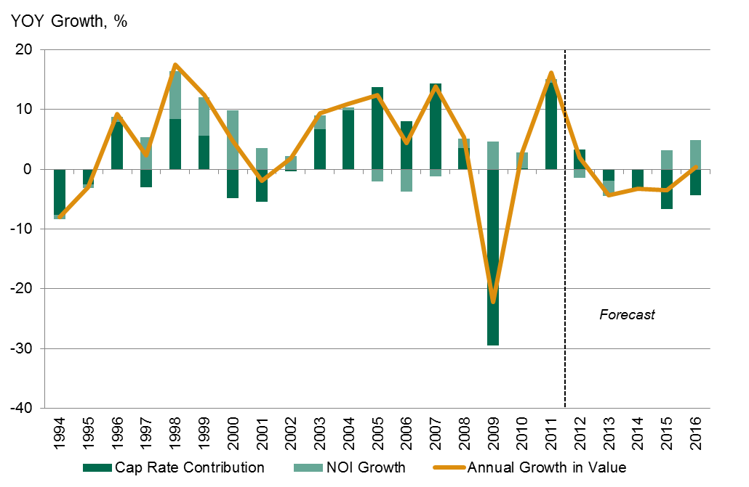
Cap Rate Contribution to Value - Office
Source: CBRE Econometric Advisors, Q3 2012
Notes:
58

Slide 59
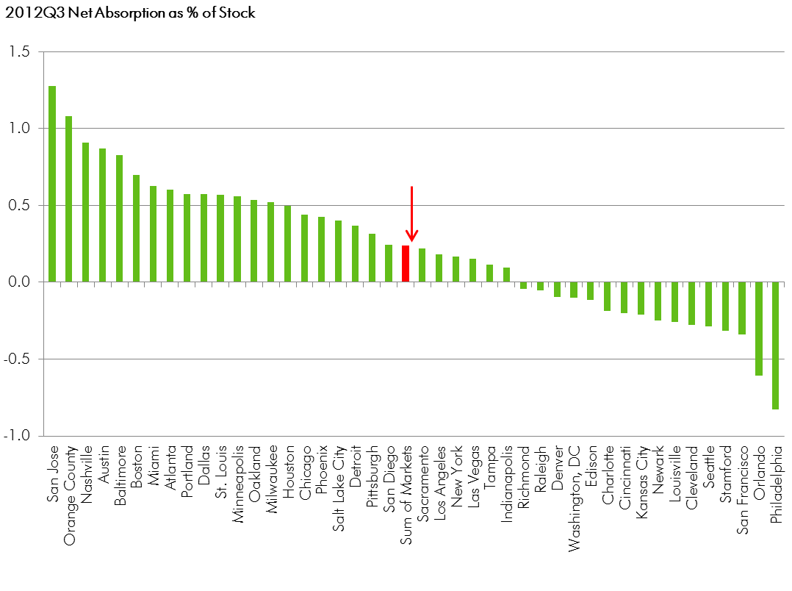
Absorption as % of Stock- Office
Source: CBRE Econometric Advisors, Q3 2012

Slide 60
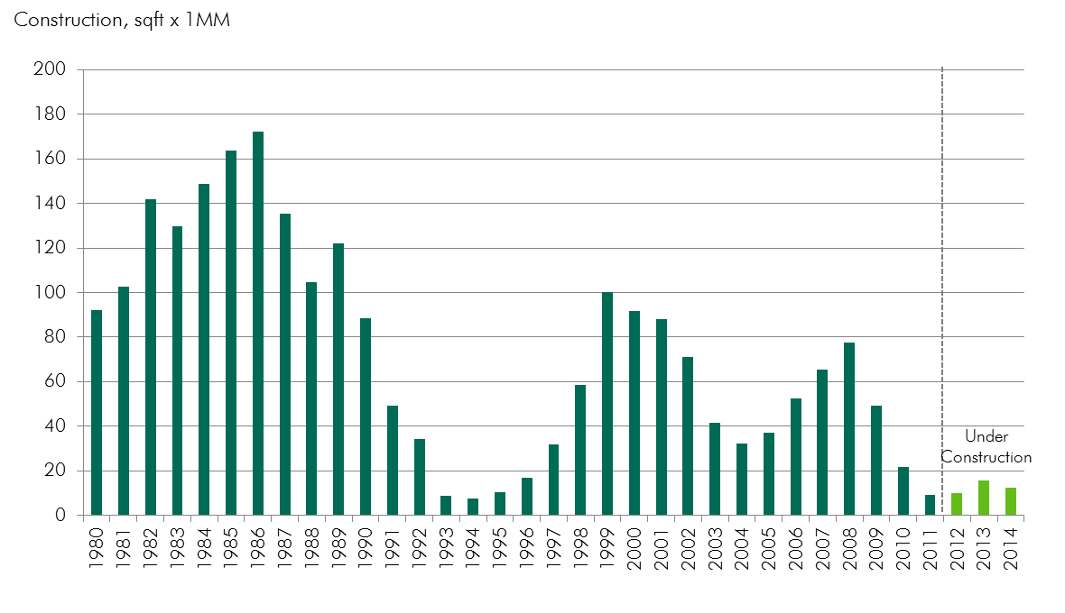
Office Supply History
Source: CBRE Econometric Advisors, Q3 2012

Slide 61
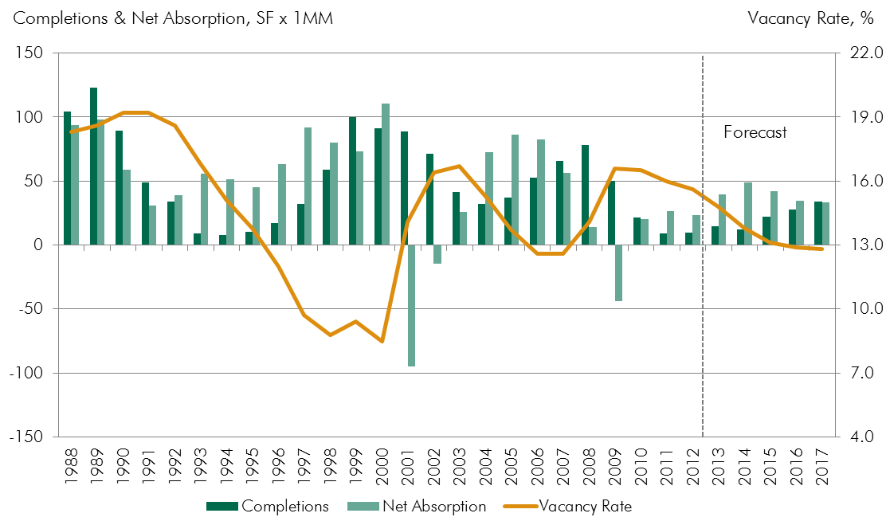
Current State of the US Office Market: Supply & Demand
Source: CBRE Econometric Advisors, Q3 2012
Notes:
61

Slide 62
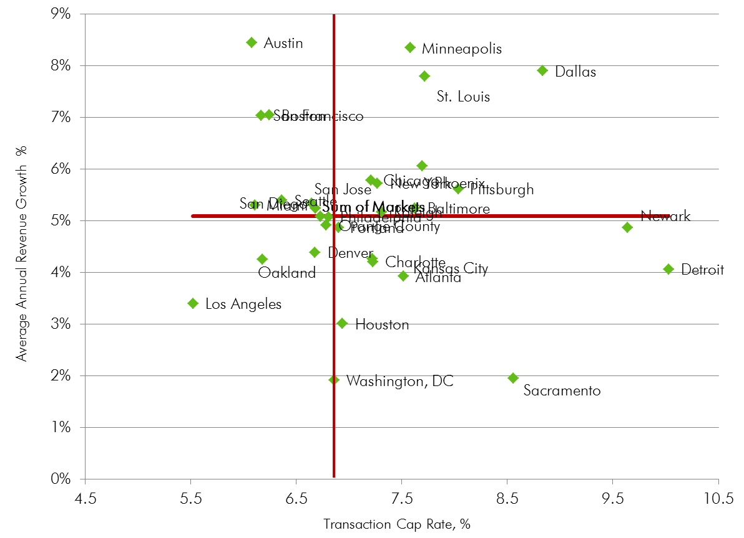
Average Annual Revenue Growth - Office
Source: CBRE Econometric Advisors, Q3 2012
Notes:
62

Slide 63
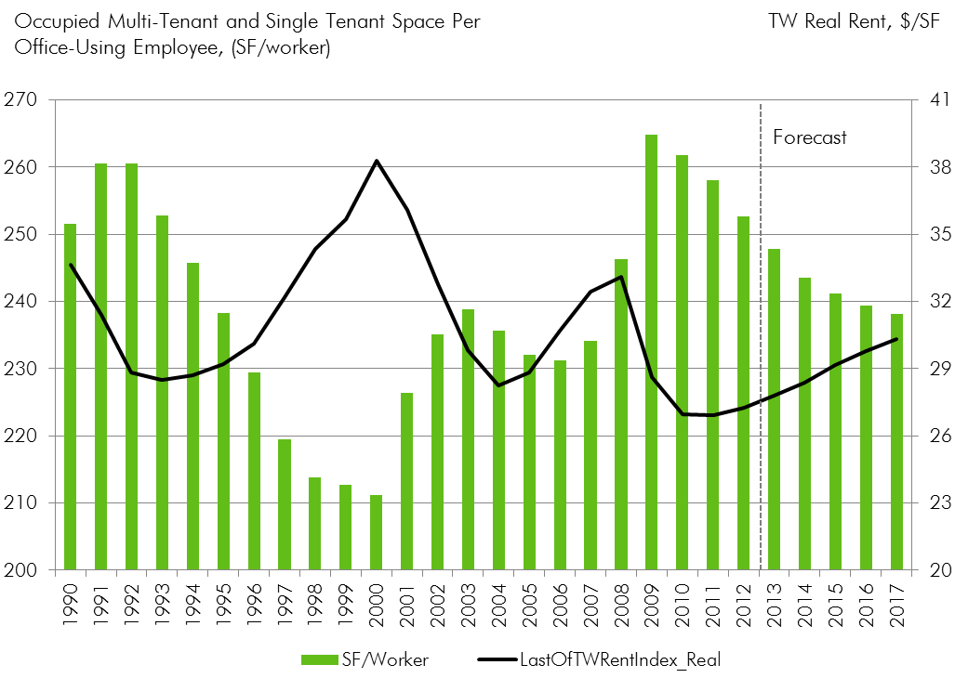
Space Per Worker - Office
Source: CBRE Econometric Advisors, Q3 2012
Notes:
63

Slide 64
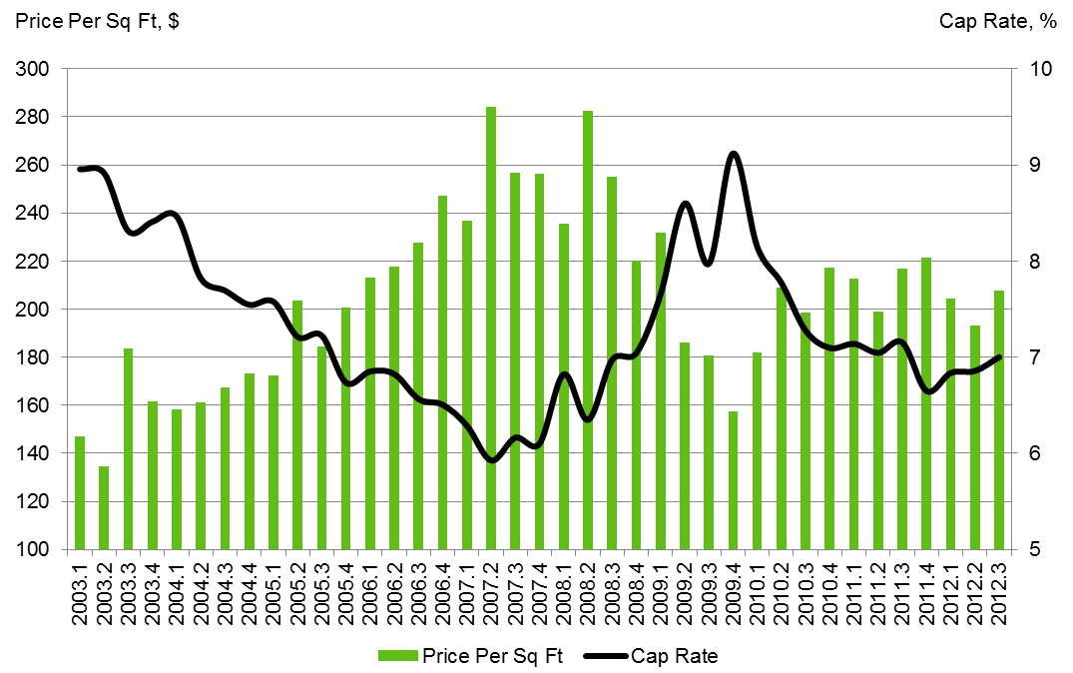
National Trends - Office
Source: CBRE Econometric Advisors, Q3 2012
Notes:
64

Slide 65
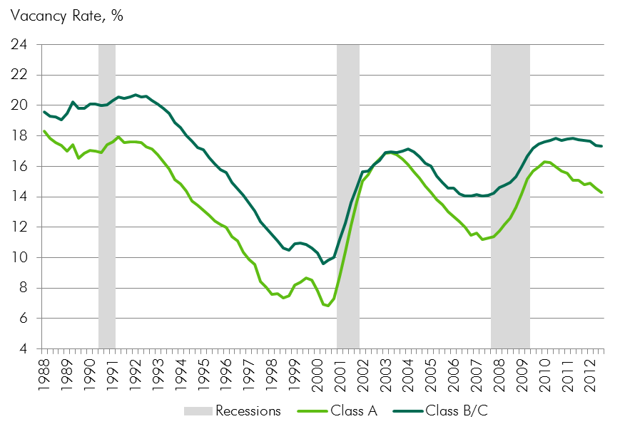
Flight to Quality - Office
Source: CBRE Econometric Advisors, Q3 2012
Notes:
65

Slide 66
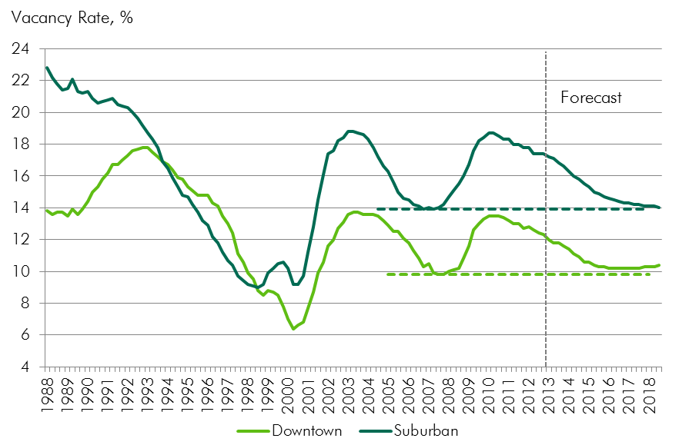
Vacancy by Area - Office
Source: CBRE Econometric Advisors, Q3 2012
Notes:
66

Slide 67
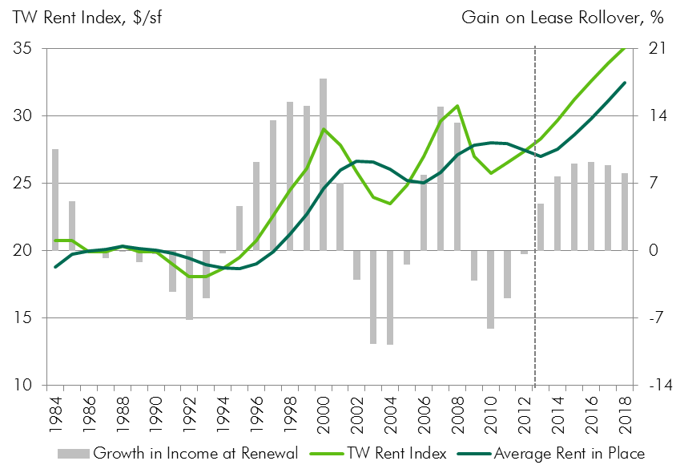
Office Rental Trends
Source: CBRE Econometric Advisors, Q3 2012
Notes:
67

Slide 68
Limited Supply Underway - Office
Source: CBRE Econometric Advisors, Q3 2012
Notes:
68

Slide 69
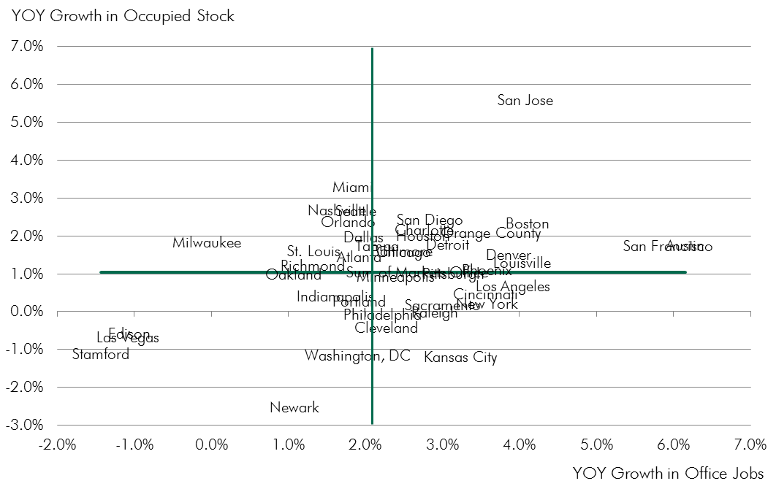
Demand by Market - Office
Source: CBRE Econometric Advisors, Q3 2012
Notes:
69

Slide 70
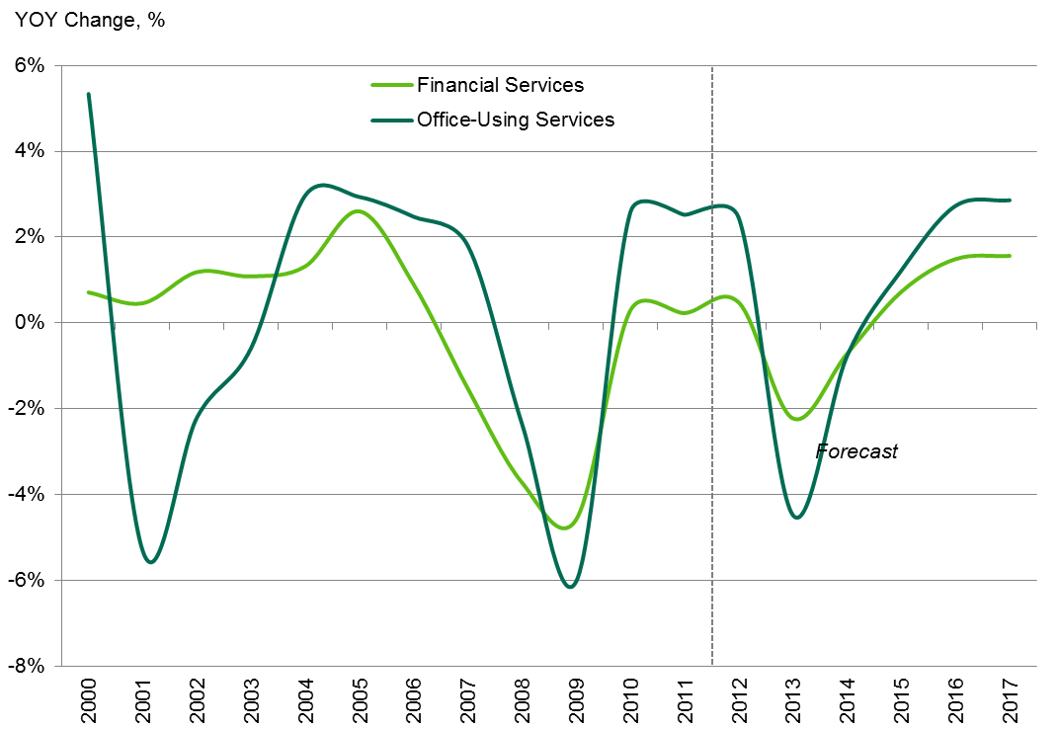
Office-Using Services Employment Forecast
Source: CBRE Econometric Advisors, Q3 2012
Notes:
70

Slide 71
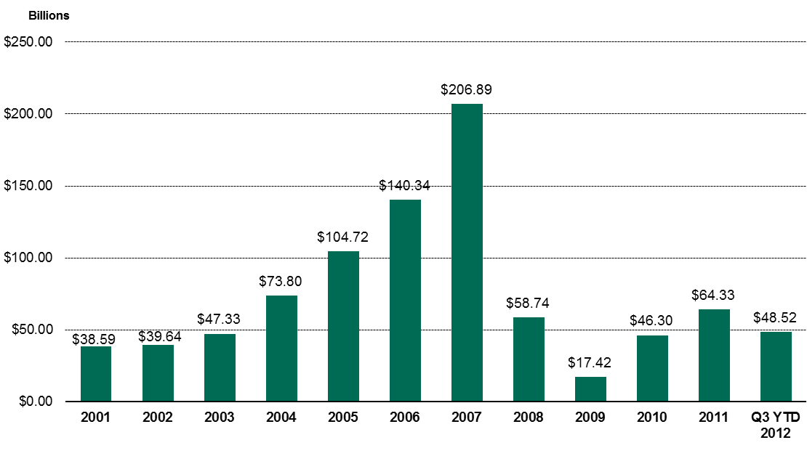
Office Transaction Volume – Total Price
Source: Real Capital Analytics, Q3 2012
Notes:
71

Slide 72
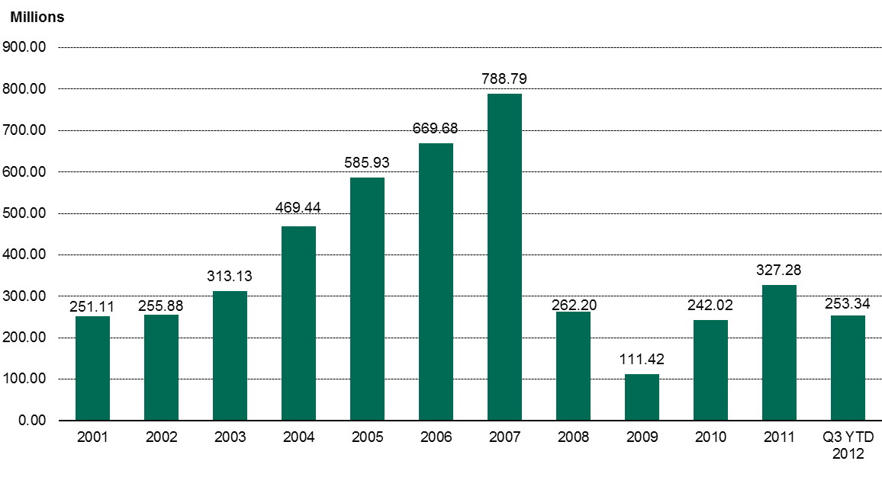
Office Transaction Volume – Total Units
Source: Real Capital Analytics, Q3 2012
Notes:
72

Slide 73
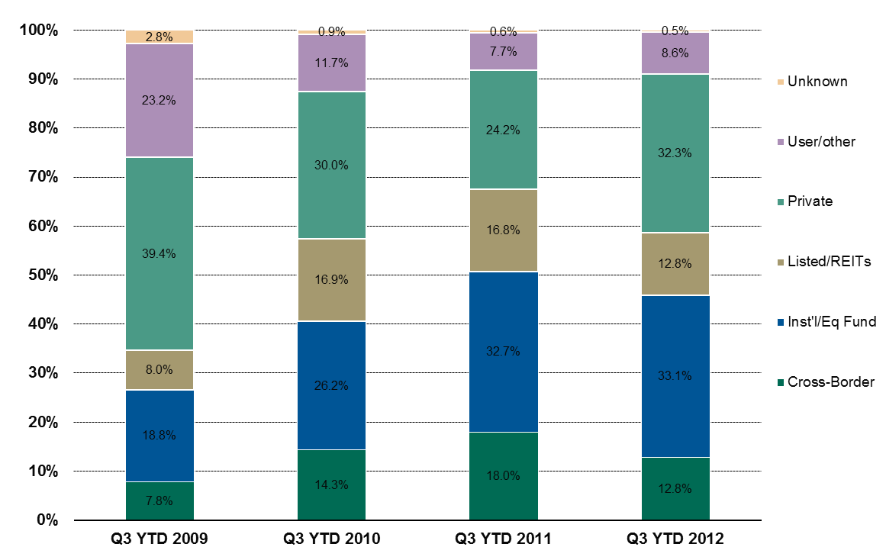
Buyer Composition - Office
Source: Real Capital Analytics, Q3 2012
Notes:
73

Slide 74
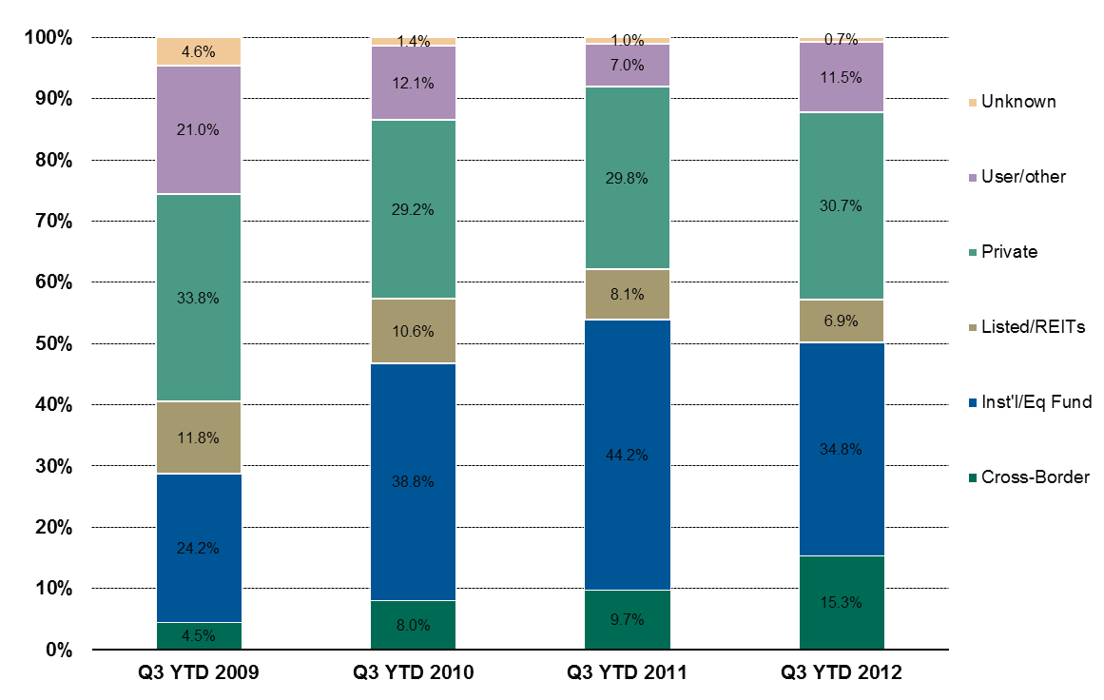
Seller Composition - Office
Source: Real Capital Analytics, Q3 2012
Notes:
74

Slide 75
Q3 YTD 2012 Office Activity by Region
Source: Real Capital Analytics, Q3 2012
Notes:
75

Slide 76
Most Active Buyers - Office
Trailing 12
Source: Real Capital Analytics, October 2012
Notes:
76

Slide 77
Most Active Sellers - Office
Trailing 12
Source: Real Capital Analytics, October 2012
Notes:
77

Slide 78
Most Active Markets - Office
Trailing 12
Source: Real Capital Analytics, October 2012
Notes:
78

Slide 79
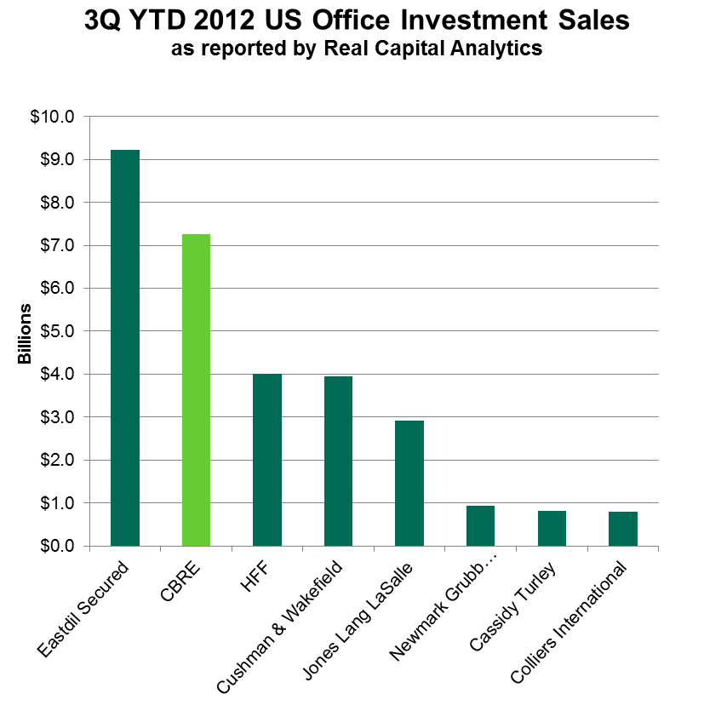
Real Capital Analytics 3Q YTD 2012 Office Broker Rankings
Includes Transactions over $2.5 million
Source: Real Capital Analytics
Notes:
Sales of significant office properties totaled $14.8b in Q2, a slight gain from the prior quarter but off 10% YOY.
For H1’12, a total of $29.2b of office property sales were recorded, up 6% compared to H1’11, with the number of properties trading increasing by 24% to total 1,200
Portfolio transactions have been a bright spot so far in 2012 with over $5.3b of transactions, double the volume from H1’11
The Q2 decline in volume from a year ago was due solely to a 18% drop in sales of CBD properties while suburban properties experienced a slight gain
The drop in the CBD sector is likely temporary – in July alone nearly $5.0b of CBD towers have either closed or been put under contract
79

Slide 80
Industrial Property Overview

Slide 81
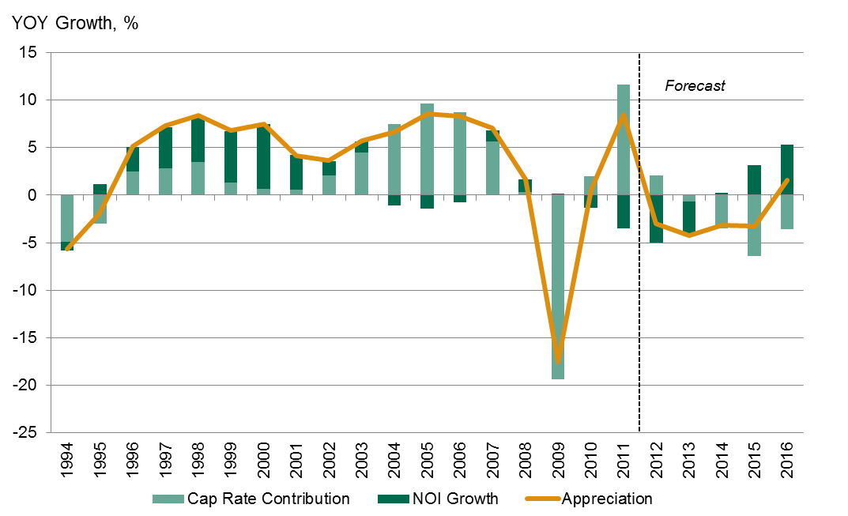
Cap Rate Contribution to Value - Industrial
Source: CBRE Econometric Advisors, Q3 2012
Notes:
81

Slide 82
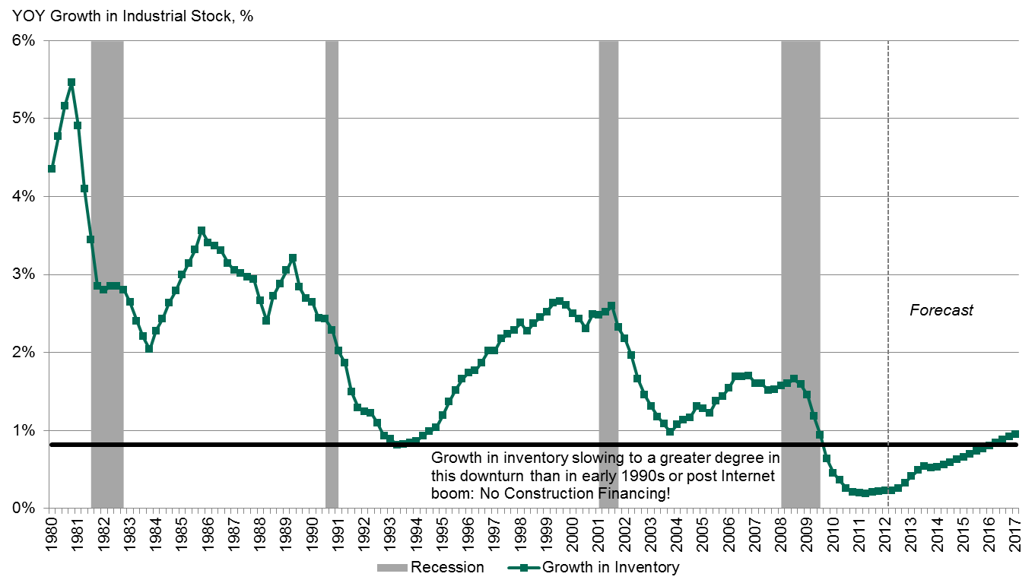
Growth in Industrial Stock as it relates to Inventory
Source: CBRE Econometric Advisors, Q3 2012
Notes:
82

Slide 83
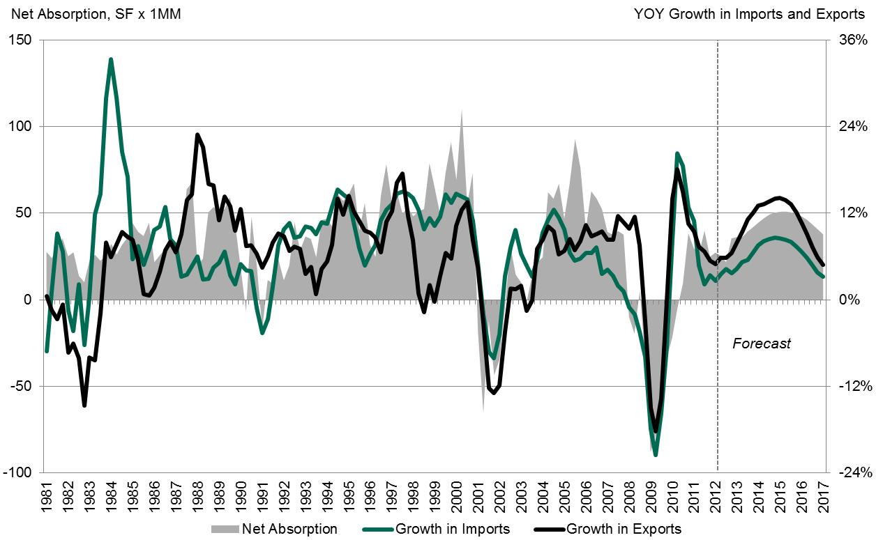
Growth in Imports and Exports
Source: CBRE Econometric Advisors, Q3 2012
Notes:
83

Slide 84
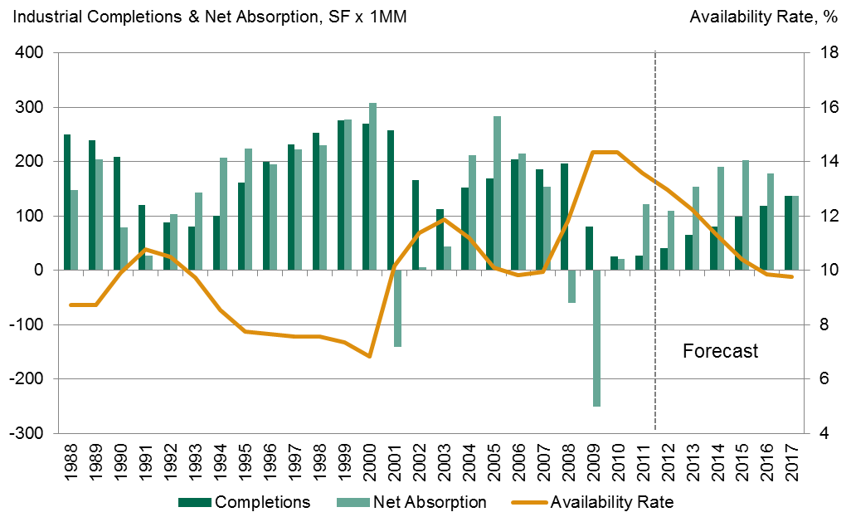
Current State of the US Industrial Market: Supply & Demand
Source: CBRE Econometric Advisors, Q3 2012
Notes:
84

Slide 85
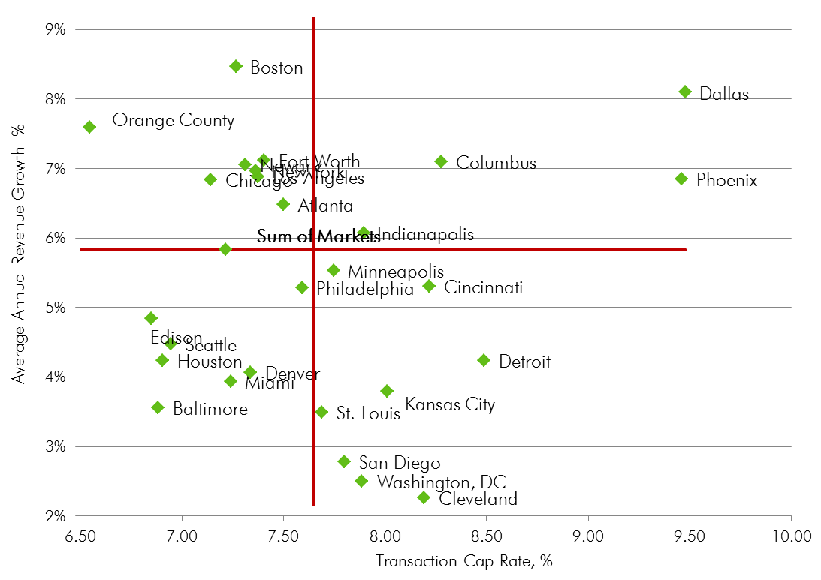
Average Annual Revenue Growth - Industrial
Source: CBRE Econometric Advisors, Q3 2012
Notes:
85

Slide 86
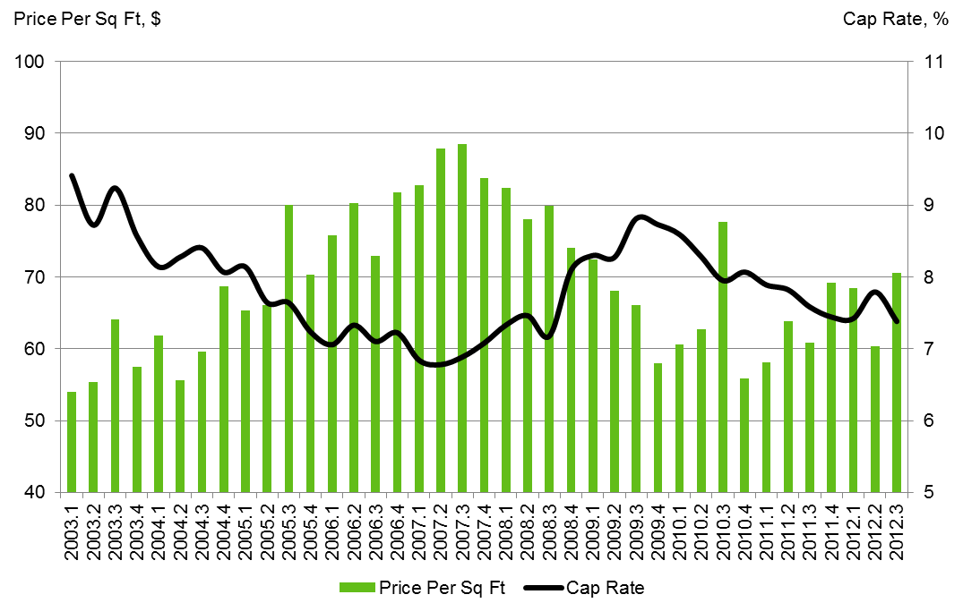
National Trends - Industrial
Source: CBRE Econometric Advisors, Q3 2012
Notes:
86

Slide 87
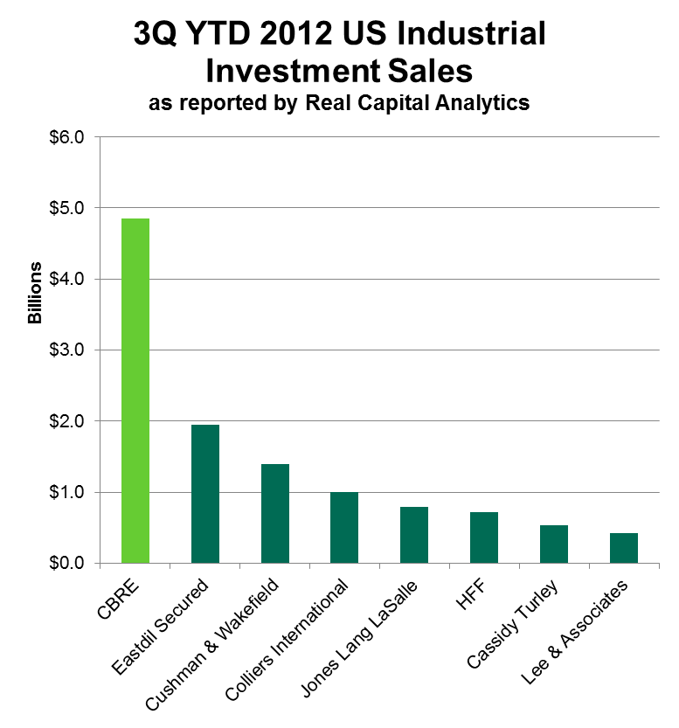
Real Capital Analytics 3Q YTD 2012 Industrial Broker Rankings
Includes Transactions over $2.5 million
Source: Real Capital Analytics
Notes:
Sales of significant industrial properties totaled $8.4b in Q2, up substantially from the prior quarter but off 44% compared to a year earlier
This is due to the AMB/Prologis merger
For H1’12, a total of $14.2b of industrial sales were recorded, down 27% compared to H1’11, although up 23% exclusive of REIT M&A
Sales of flex totaled $5.9b, registering a 46% yoy increase and accounting for 41% of volume in H1
Warehouse properties totaled $5.0b, up 11%
87

Slide 88
Retail Property Overview

Slide 89
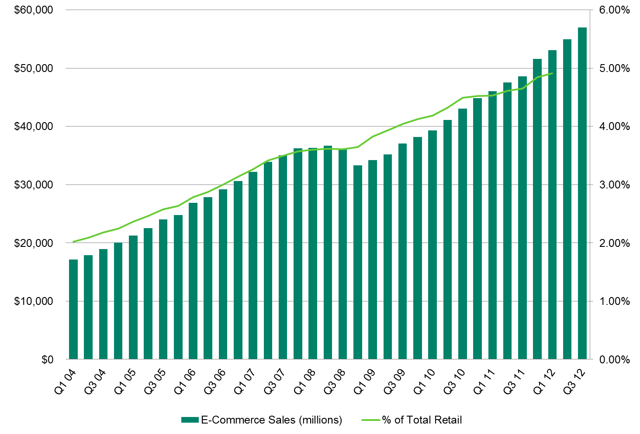
Quarterly US Retail E-Commerce Sales
Source: US Department of Commerce, data through Q3 2012
Estimates are based on data from the Monthly Retail Trade Survey, and are adjusted for seasonal variation, but not for price changes

Slide 90
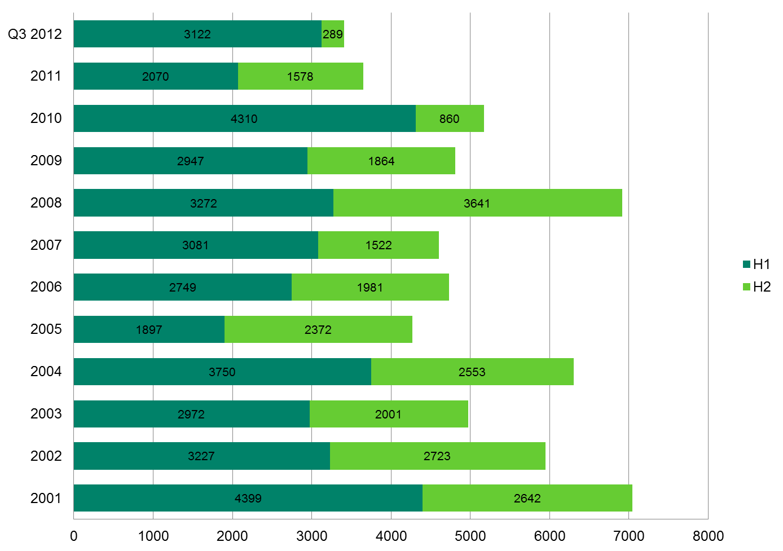
Store Closings
US Announced Store Closings 2001 –Q3 2012
Source: U.S. Retail Real Estate Supply Conditions, PNC Real Estate And ICSC Research
Updated: Q3 2012

Slide 91
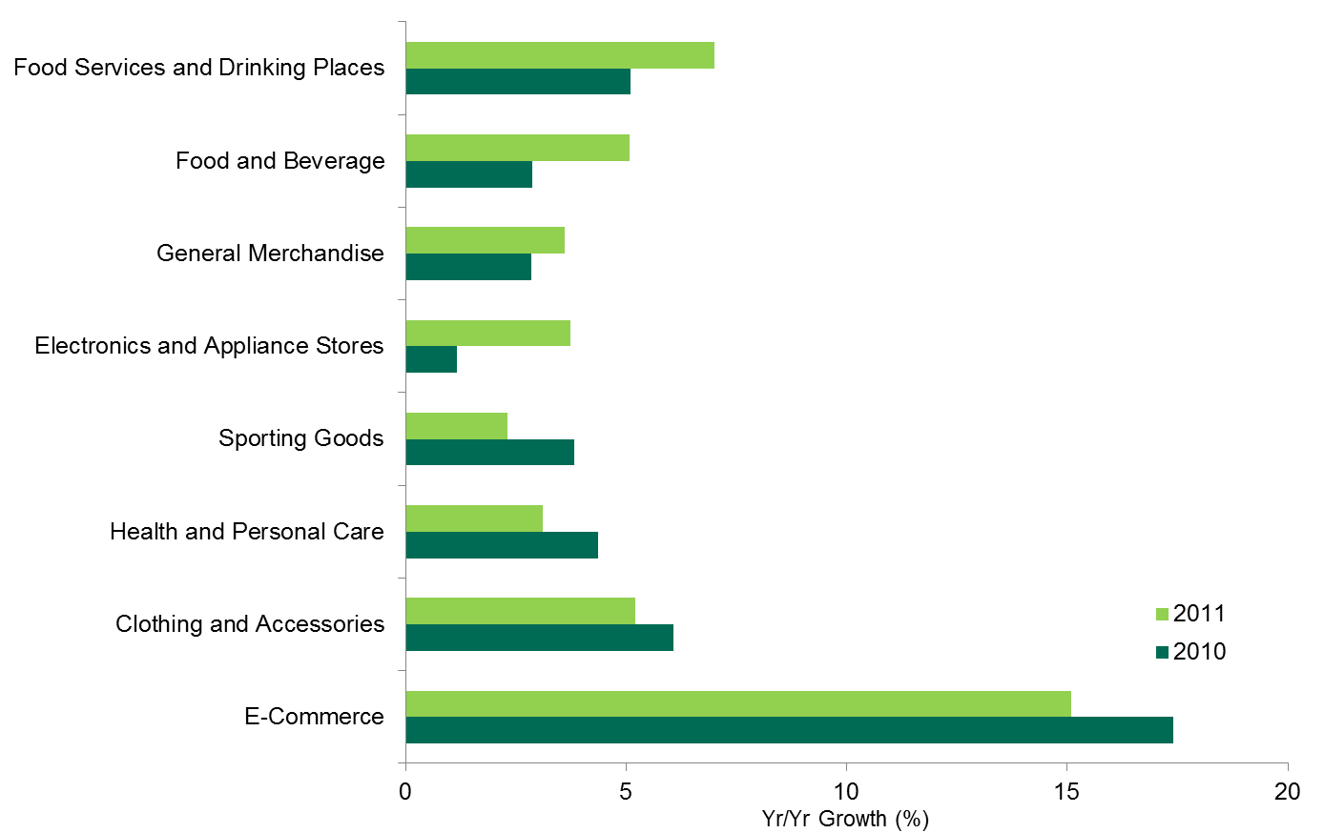
Performance In Past Two Holiday Seasons
Source: Census Bureau

Slide 92

Modest But Consistent Retail Recovery
Source: CBRE Econometric Advisors

Slide 93

Positive But Below 1% Rent Growth in ‘13 & ‘14
%
Source: CBRE Econometric Advisors, updated Q3 2012
Notes:
Updated

Slide 94

Retail Market Observations
United States
Sources: US Census Bureau; US Bureau of Labor Statistics; CoStar

Slide 95

Retail Transaction Volume
Billions ($) Properties – National Data
Source: Real Capital Analytics. Historical Statistics by Year (data through Q3 2012)

Slide 96

Retail Transaction Volume
Billions ($) Properties – National Data
Source: Real Capital Analytics. Historical Statistics by Year (data through Q3 2012)

Slide 97

Retail Transaction Volume
Billions ($) Properties – National Data
Source: Real Capital Analytics. Historical Statistics by Year (data through Q3 2012)

Slide 98
Retail Transaction Volume
# of Properties – National Data
Source: Real Capital Analytics. Historical Statistics by Year (data through Q3 2012)

Slide 99

Seller Composition
Source: Real Capital Analytics, Net Retail Investment (reflects sales through Q3 2012)

Slide 100
Buyer Composition
Source: Real Capital Analytics, Net Retail Investment (reflects sales through Q3 2012)

Slide 101

Retail Acquisition by Capital Sector
$ Volume (Billions)
Source: Real Capital Analytics, Net Retail Investment (represents activity through Q3 2012)

Slide 102

Net Retail Acquisitions by Capital Sector
$ Volume (Billions)
Source: Real Capital Analytics – Net Retail Investment (data through Q3 2012)

Slide 103

Cap Rate and Average Price PSF Trends
Non-Mall Properties
Source: Real Capital Analytics – US Volume/Caps/Pricing – Retail Data thru Q3 2012

Slide 104
Retail Activity by Region
Deals Closed July – September 2012
Source: Real Capital Analytics, Retail Historical Stats by Market – Data through Jul – Sept 2012

Slide 105
Retail Volume & Pricing
Non-Mall: July – September 2012
Source: Real Capital Analytics (data through July – Sept 2012)

Slide 106
Most Active Buyers
US – Retail – Past 12 Months
Source: Real Capital Analytics, Top Players and Markets – Data from December 12, 2012

Slide 107
Most Active Sellers
US – Retail – Past 12 Months
Source: Real Capital Analytics, Top Players and - Data from December 12, 2012

Slide 108
Most Active Markets
US – Retail – Past 12 Months
Source: Real Capital Analytics, Top Players and Markets - Data from December 12, 2012

Slide 109
Broker Rankings
National Data
Source: Real Capital Analytics, data through Q1 2012

Slide 110

Cap Rates by Market
Non-Mall Properties
Source: Real Capital Analytics. Data through Q3 2012

Slide 111

Average Annual Revenue Growth - Retail
Source: CBRE Econometric Advisors, Q3 2012

Slide 112

Core Growth Trending Slightly Below LT Average
Source: Census Bureau

Slide 113

Taking a Bite Out of Brick and Mortar Sales
Source: Census Bureau

Slide 114

Low Completions in the Forecast
Source: CBRE Economic Advisors

Slide 115

Availability Rates: Still Elevated but on the Right Path
Source: CBRE Economic Advisors

Slide 116

Most Large Markets Still Have High Availability Rates
Source: CBRE Economic Advisors

Slide 117
Multi-Housing Property Overview

Slide 118
Average Annual Revenue Growth
Source: CBRE Econometric Advisors, Q3 2012
Notes:
118

Slide 119
Average Annual Top Line Revenue Growth per Unit 5-Yr Forecast
Source: CBRE Econometric Advisors, Q3 2012

Slide 120
Cap Rate Contribution to Value – Multi-Housing
Source: CBRE Econometric Advisors, Q3 2012

Slide 121
Vacancy Rate Expected to Remain Near Lows Through 2016
Source: CBRE Econometric Advisors, Q3 2012

Slide 122
National Trends
Source: CBRE Econometric Advisors, Q3 2012

Slide 123
Cap Rate Forecast
Source: CBRE Econometric Advisors, Q3 2012

Slide 124
BPS Spread to Ten Year Treasury
Source: CBRE Econometric Advisors, Q2 2012

Slide 125
Cap Rate Trends
Source: Real Capital Analytics, CBRE-EA

Slide 126
Real Capital Analytics 2012 Multi-Housing Broker Rankings
Through 3Q12; Includes Transactions over $2.5 million
Source: Real Capital Analytics
Notes:
126

